Slide 1
Data Visualization in R with ggplot2
Dr. Chris Bird
Texas A&M University – Corpus Christi

Slide 2
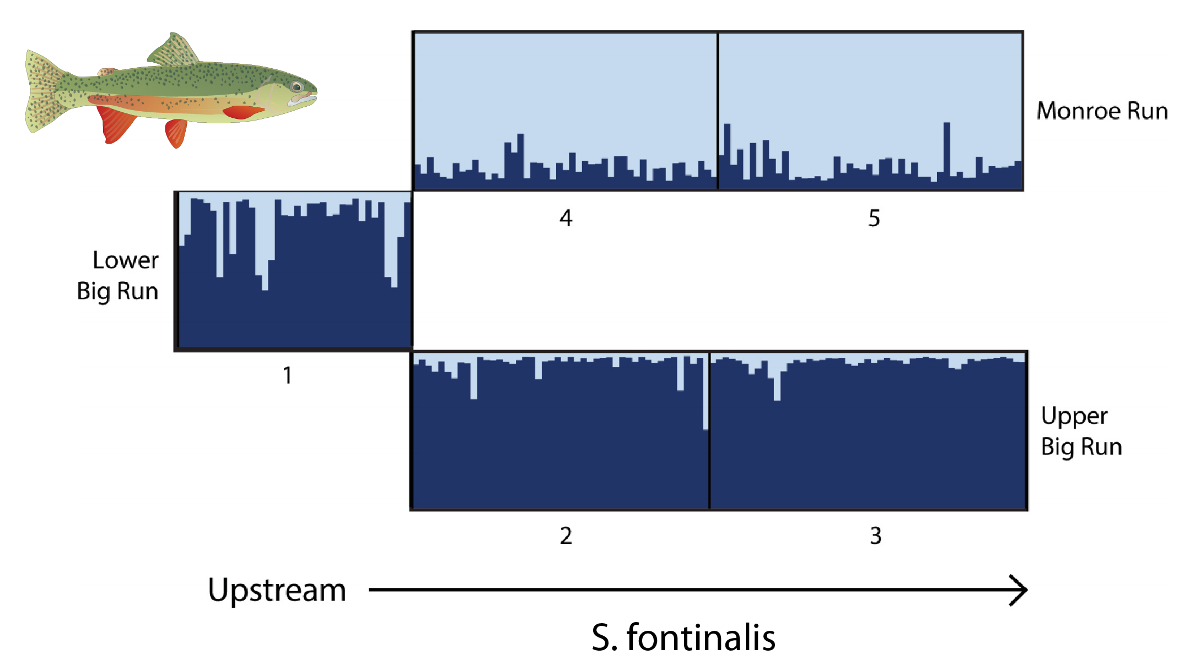
Scientific Visualizations Should be Clear
What is being plotted?
What are the axes?
What do the colors, shapes, & sizes represent?
What is the message you want to convey?
What’s wrong with this figure?

Slide 3
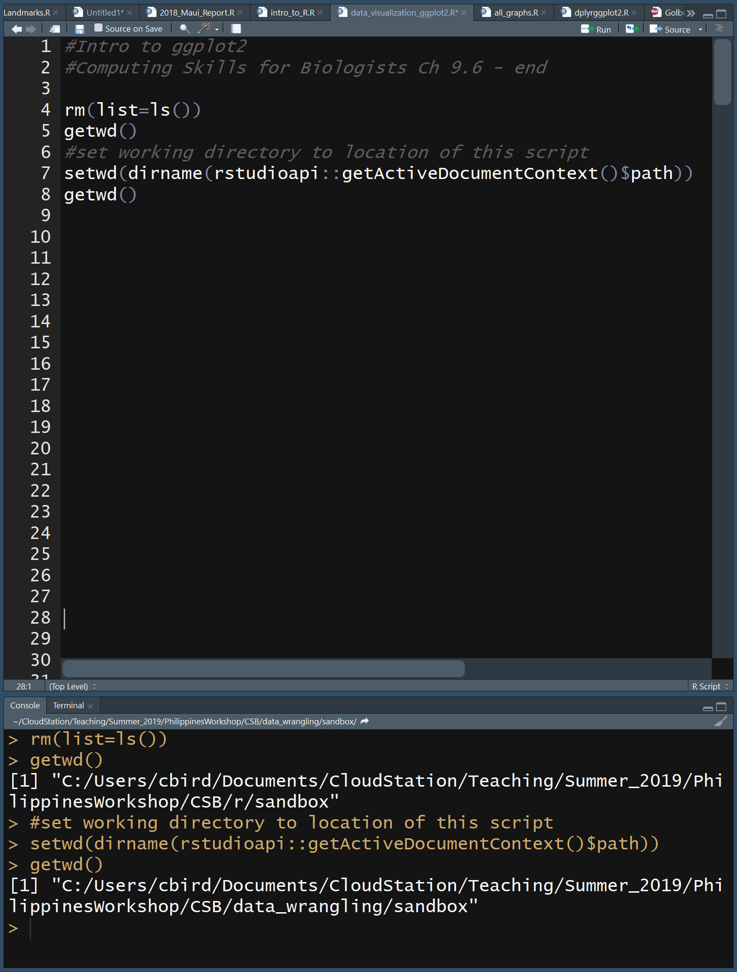
Make a New R Script
CSB\data_wrangling\sandbox\data_visualization_ggplot2.R
Clear the environment
Set the working directory to same location as this R script

Slide 4
Philosophy of ggplot2
The grammar of graphics (Wilkinson 2006)
Describe a graph using text
Data – data frame to plot
Aesthetic Mapping (aes)
which parts of data frame are associated with which parts of plot
X-axis, Y-axis, colors of points, etc
Geometry (geom)
Lines, points, etc
Coordinates
cartesian, polar
Faceting
Panels
Statistics
Fit line, smoothing, etc
Theme
Adjust look and feel of the graphics

Slide 5
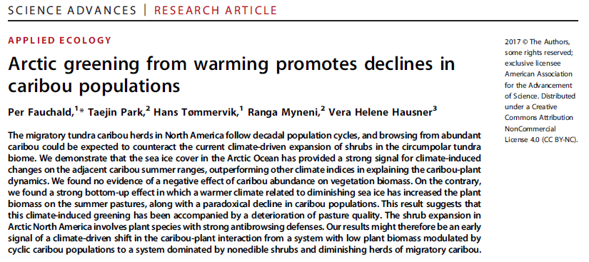
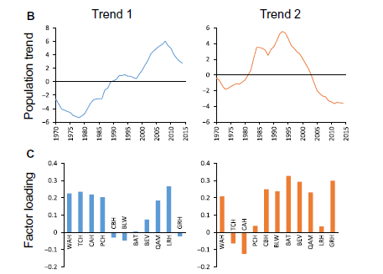
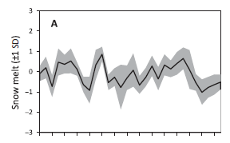
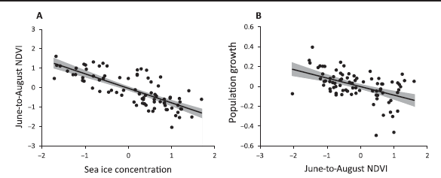

Slide 6
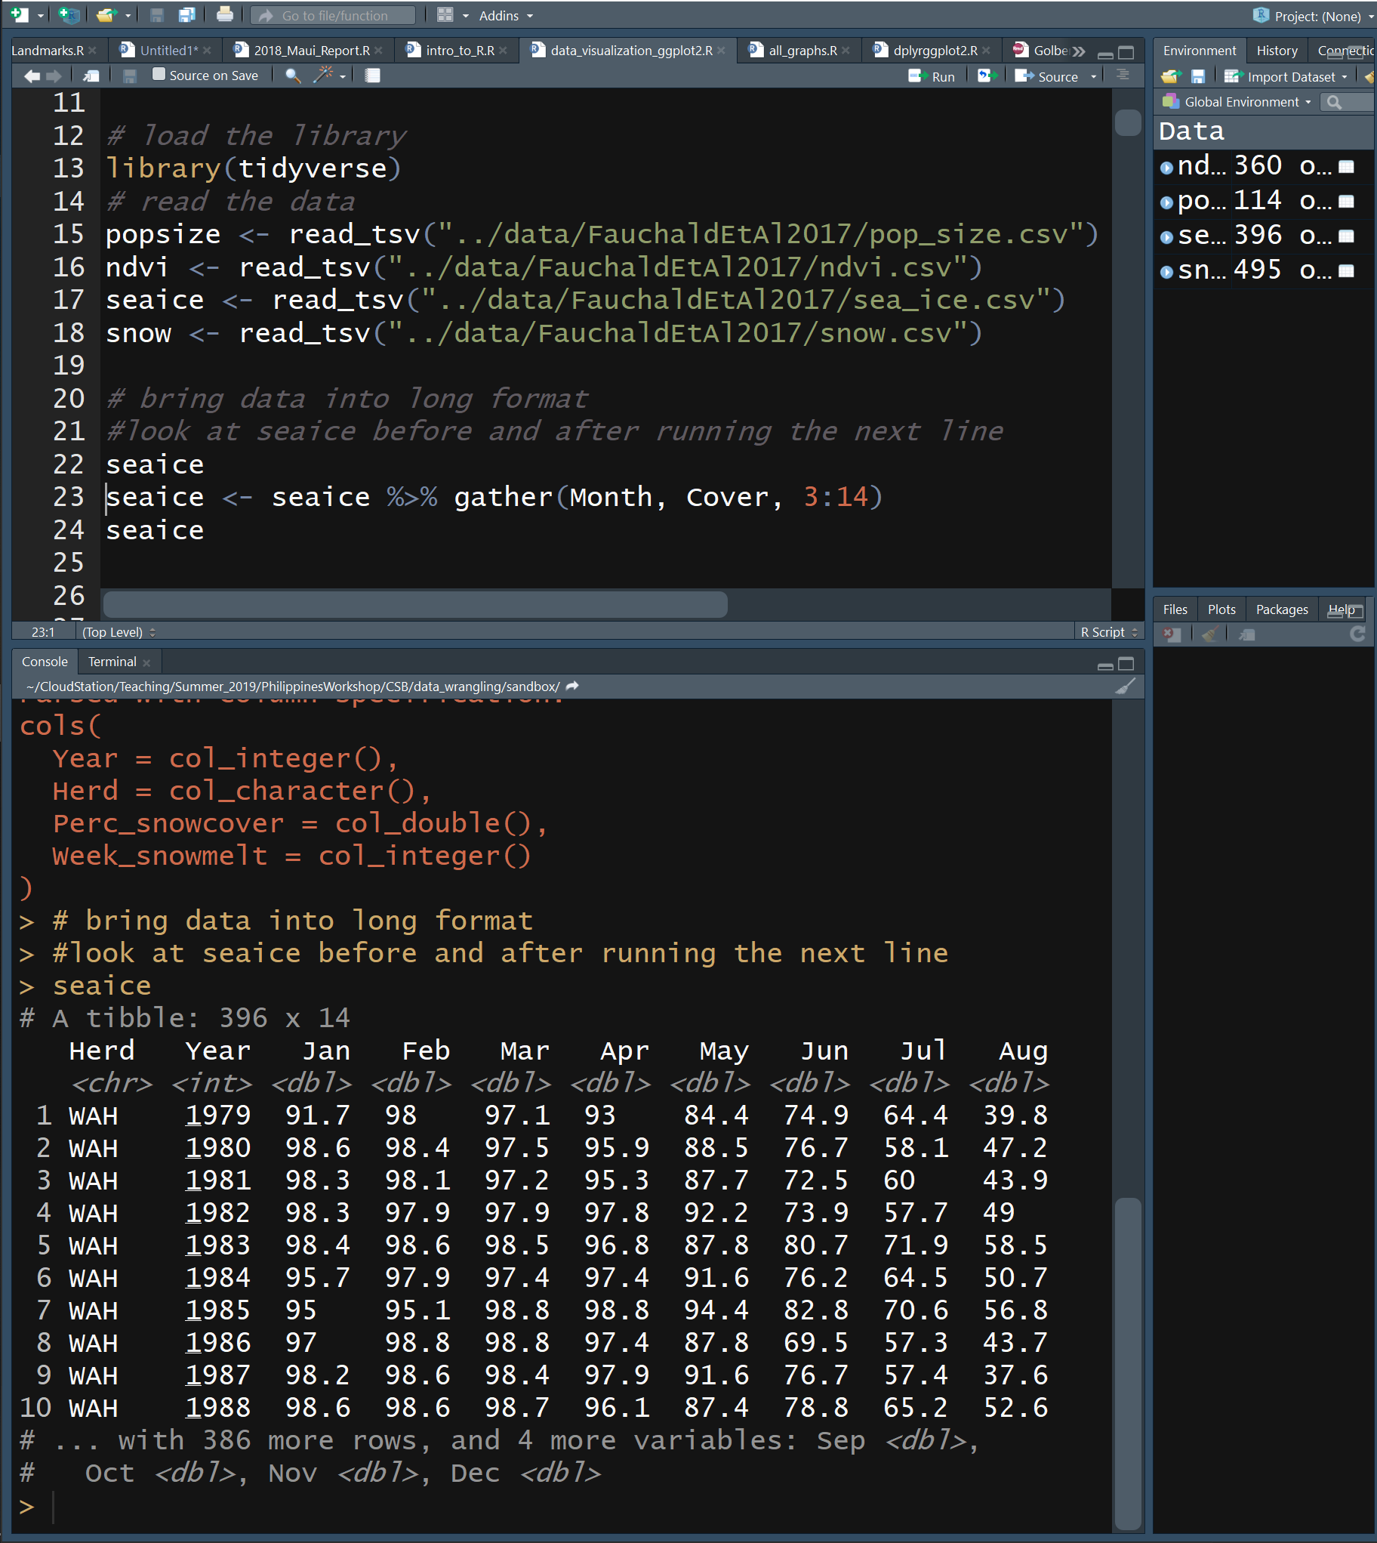
Load Data
Tidyverse
A package to manipulate data
The new commands we are using are part of “the tidyverse” as is ggplot2
Data frames are called “tibbles”
popsize, ndvi, seaice, & snow are tibbles
New commands
%>% - a data pipe, like | in linux
gather(groupColName, dataColName, columns_to_stack)
Stacks data columns
Look at seaice before and after gather

Slide 7
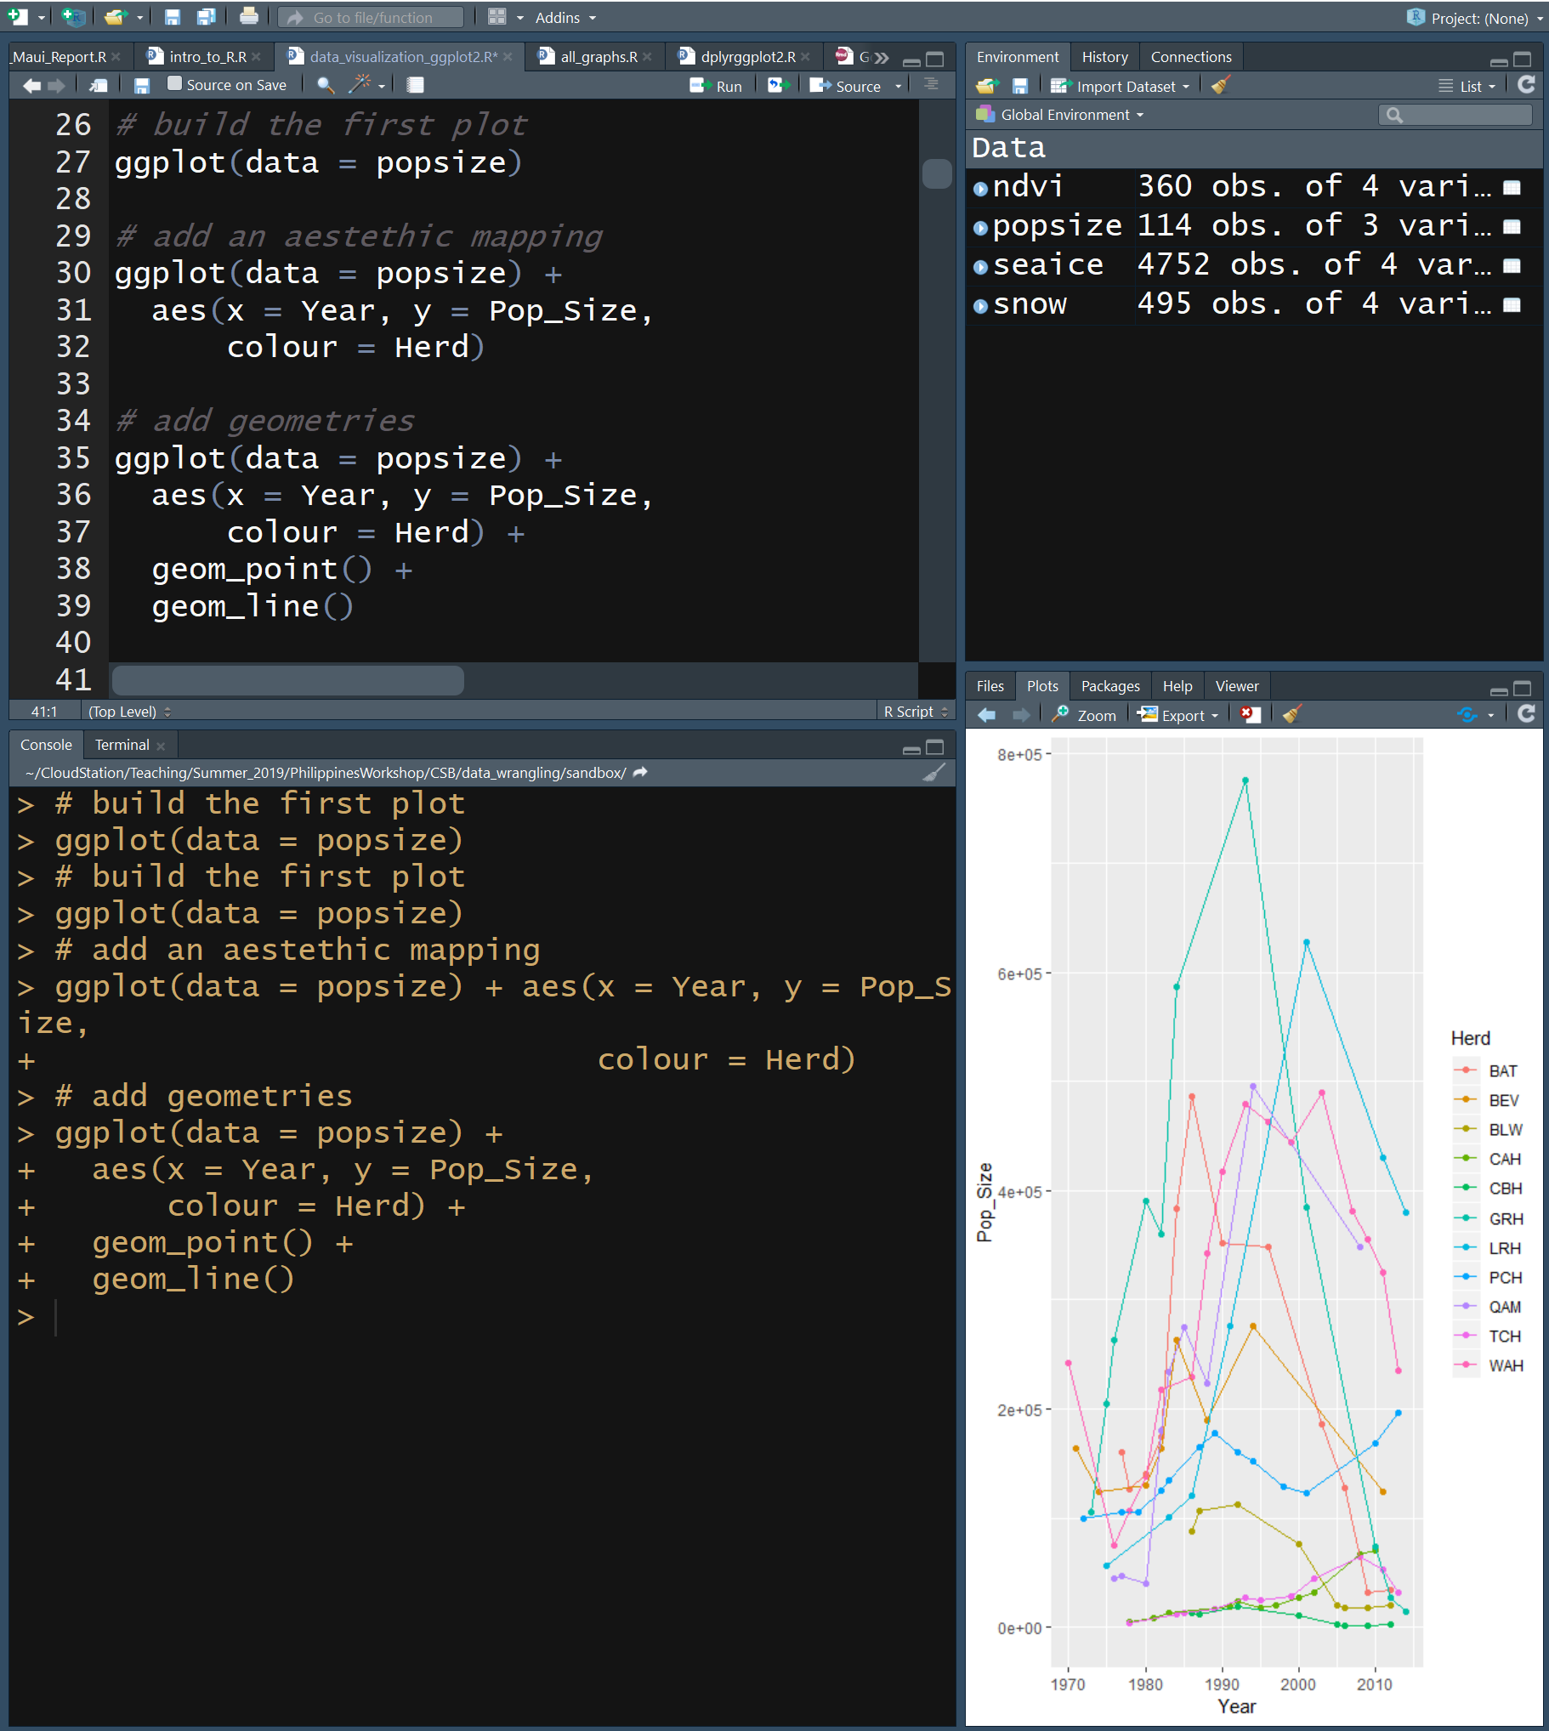
Building a ggplot
Plot Pop_Size vs Year by Herd
Add data
data = popsize
Add aesthetics (aes)
x = Year
y = Pop_Size
colour = herd
Add data point geometry
geom_point()
Add line geometry
geom_line()
Note the use of + to continue the “sentence”

Slide 8
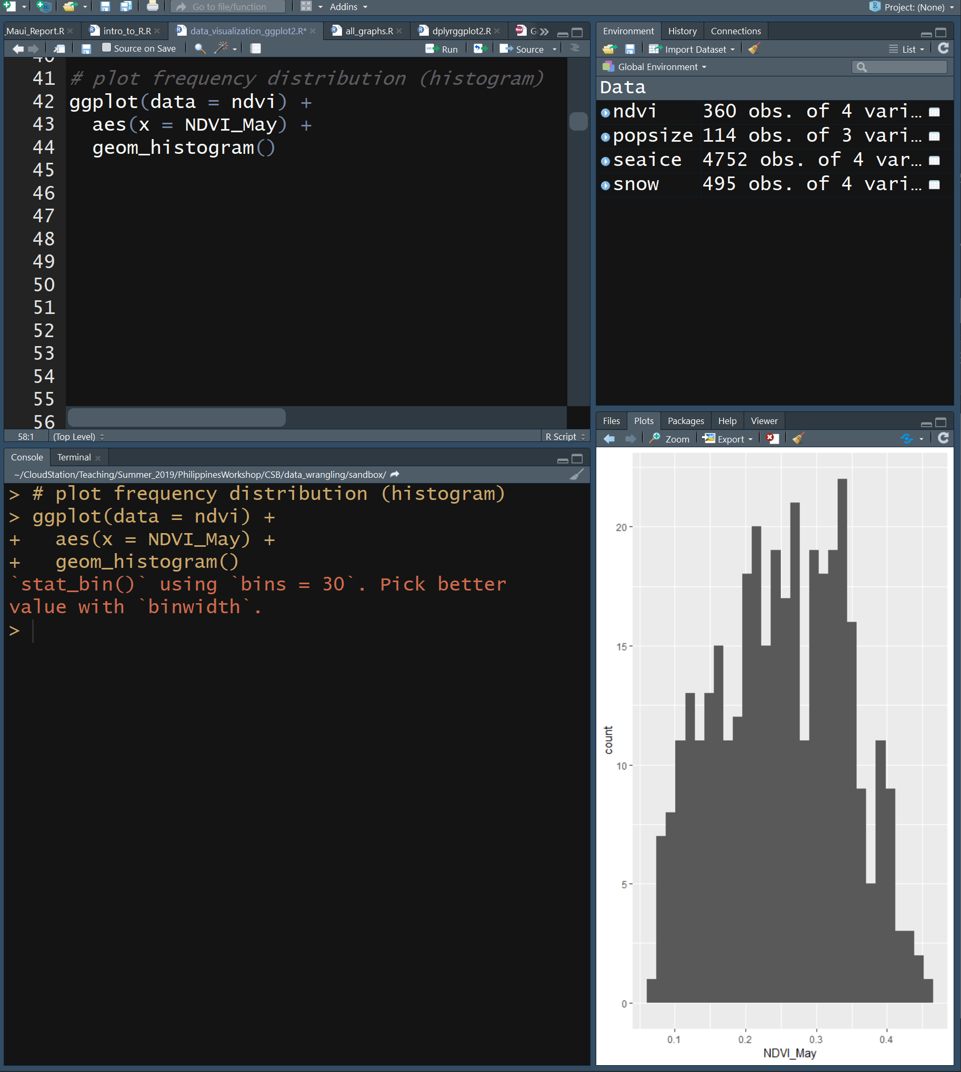
Frequency Distribution
Add data
data = ndvi
Add aesthetics
aes(x = NDVI_May)
Add data point geometry
geom_histogram()
What is NDVI?
Check Fauchald et al

Slide 9
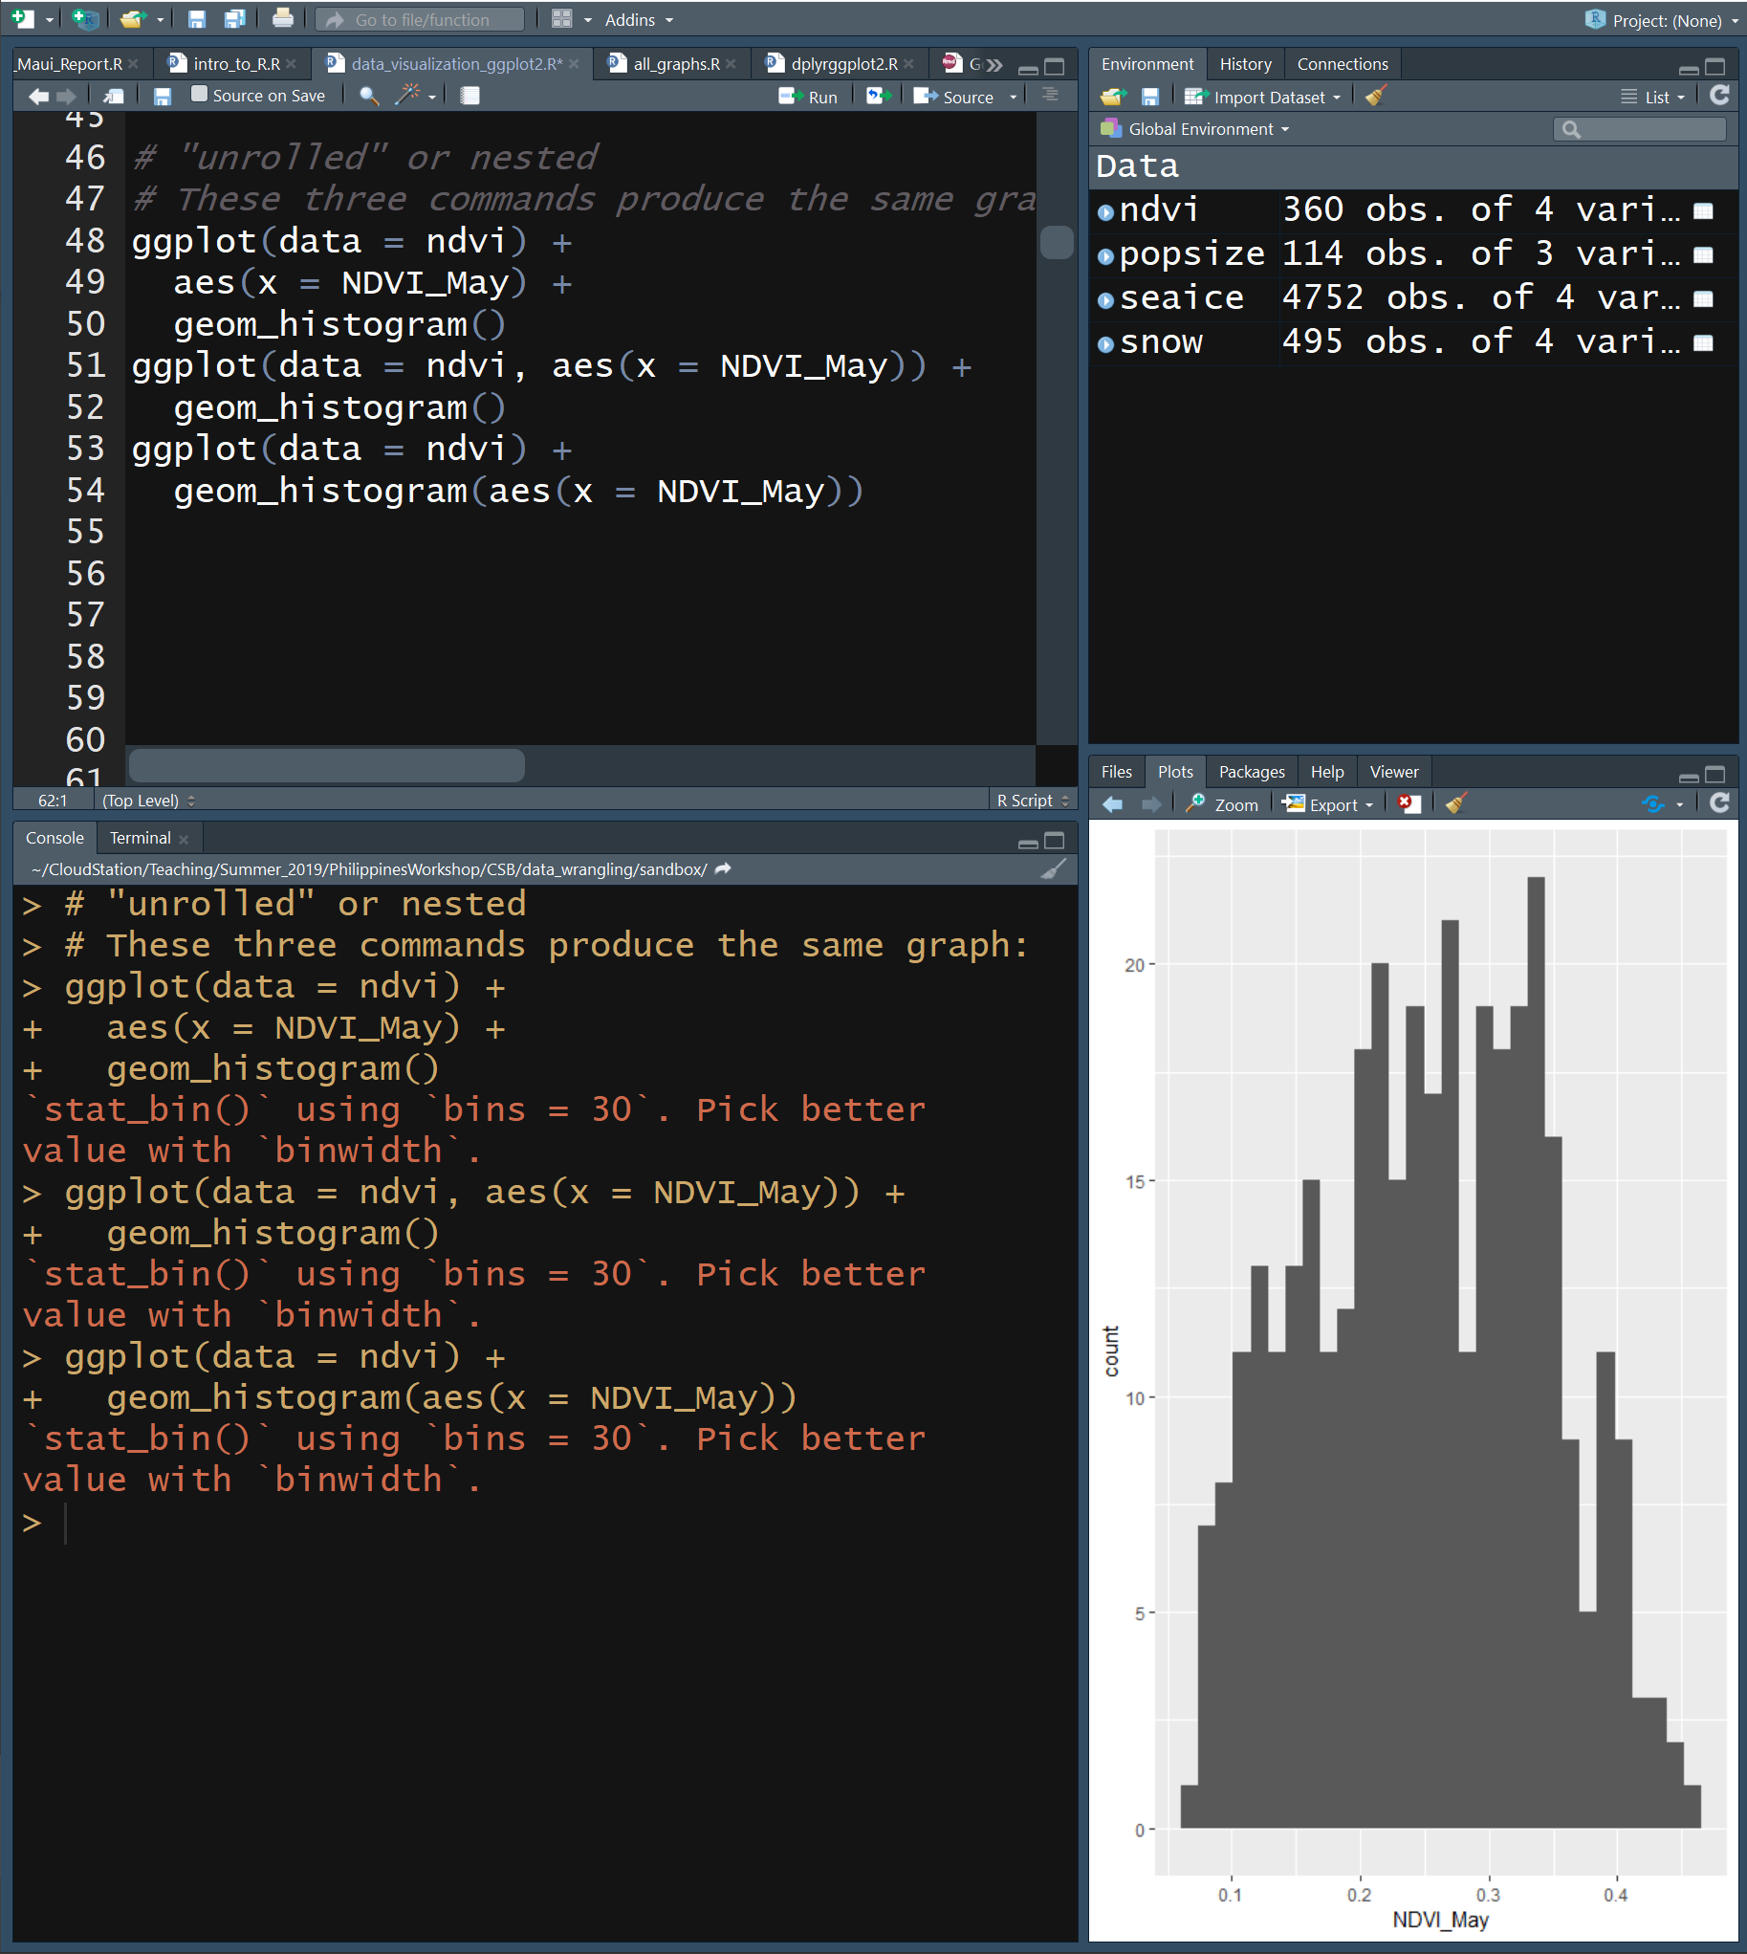
Nested vs Unrolled
The same plot can be made using the same commands arranged in different ways
Nesting
ggplot(data = ndvi, aes(x = NDVI_May))
Unrolled
ggplot(data = ndvi) +
aes(x = NDVI_May) +
geom_histogram()
Note the use of + to continue the “sentence”

Slide 10
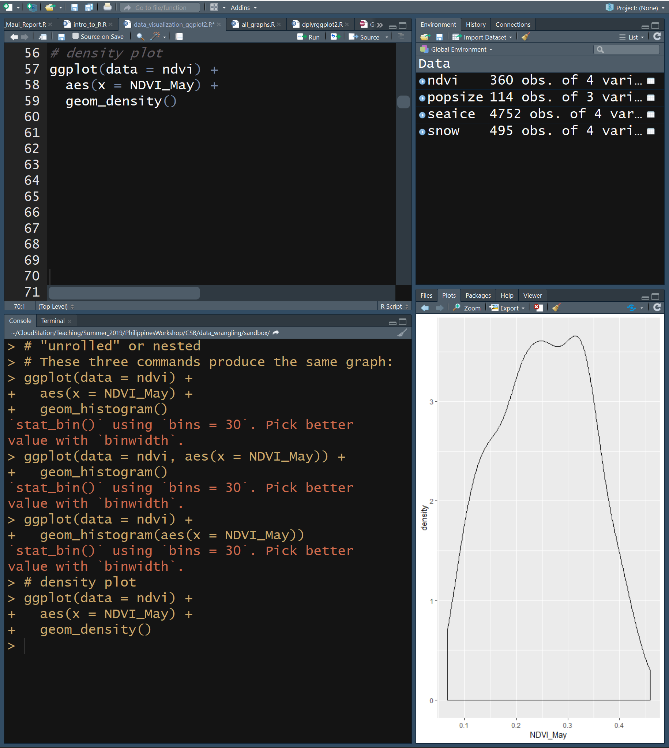
Density Plot
Interpolated from histogram
Note the use of + to continue the “sentence”

Slide 11
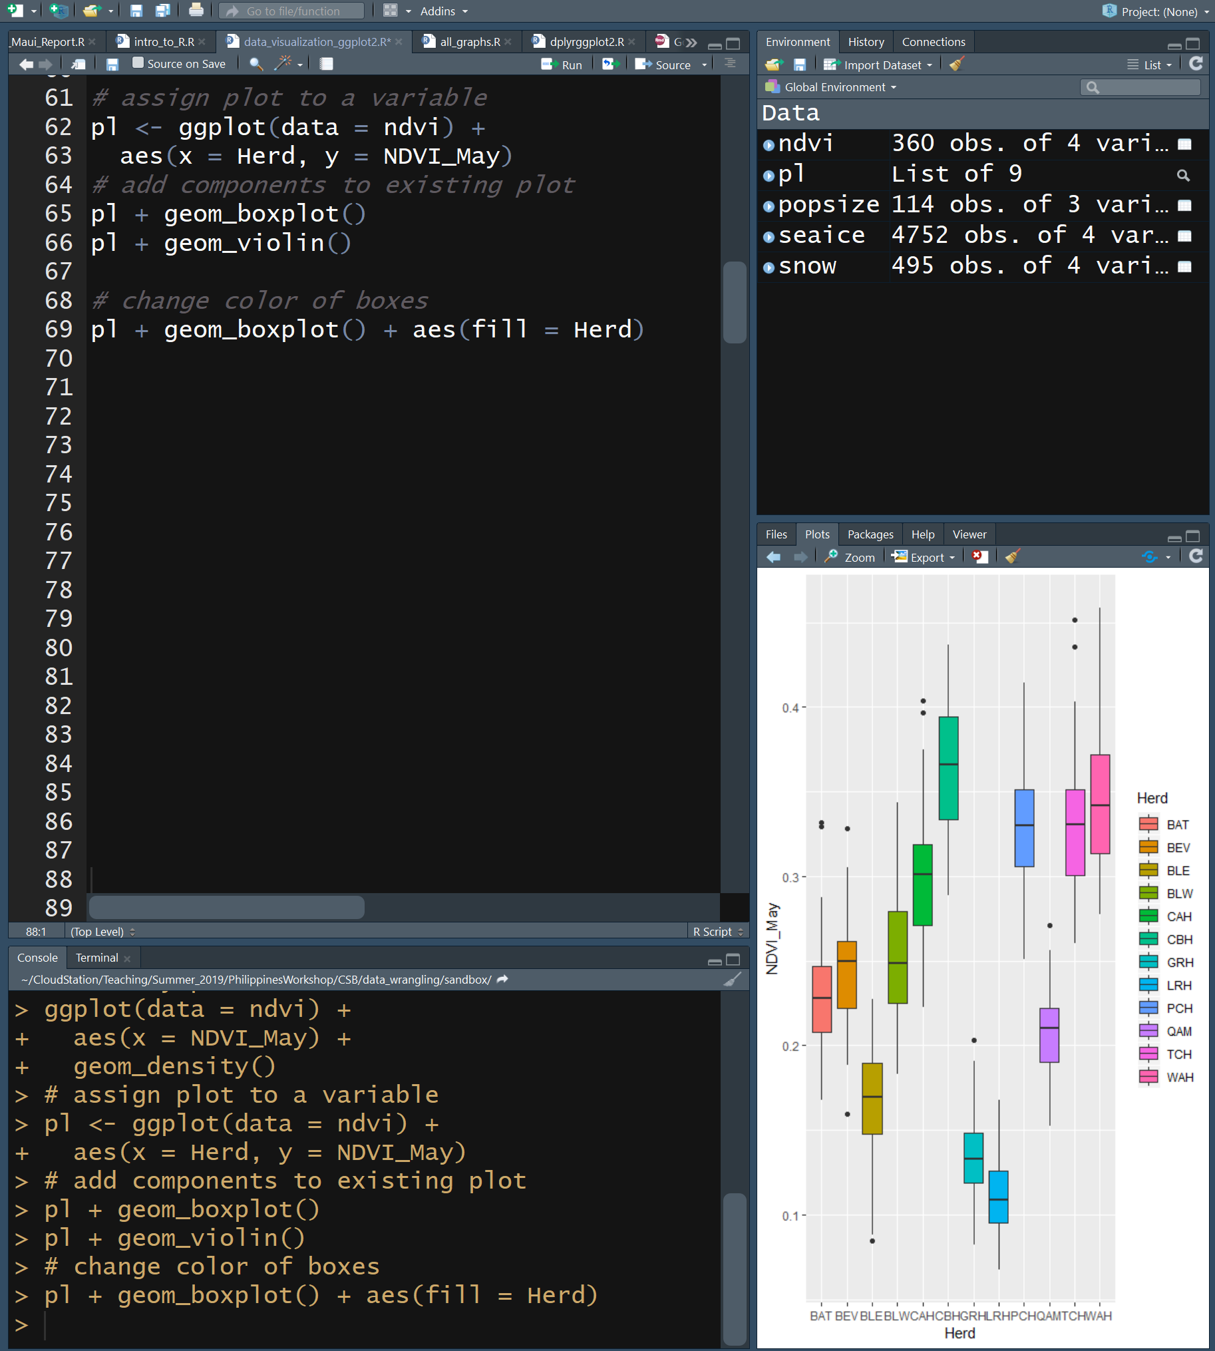
Box & Violin Plots
Provide info on distribution of your data
Box plot
Box is 25, 50 & 75th percentiles
Whiskers are interquartile range, 1.5x length of box
Points are outliers
Violin plot
Wider = more data points
Plot can be assigned to variable
Color can be added to plots using fill aesthetic
Note the use of + to continue the “sentence”

Slide 12
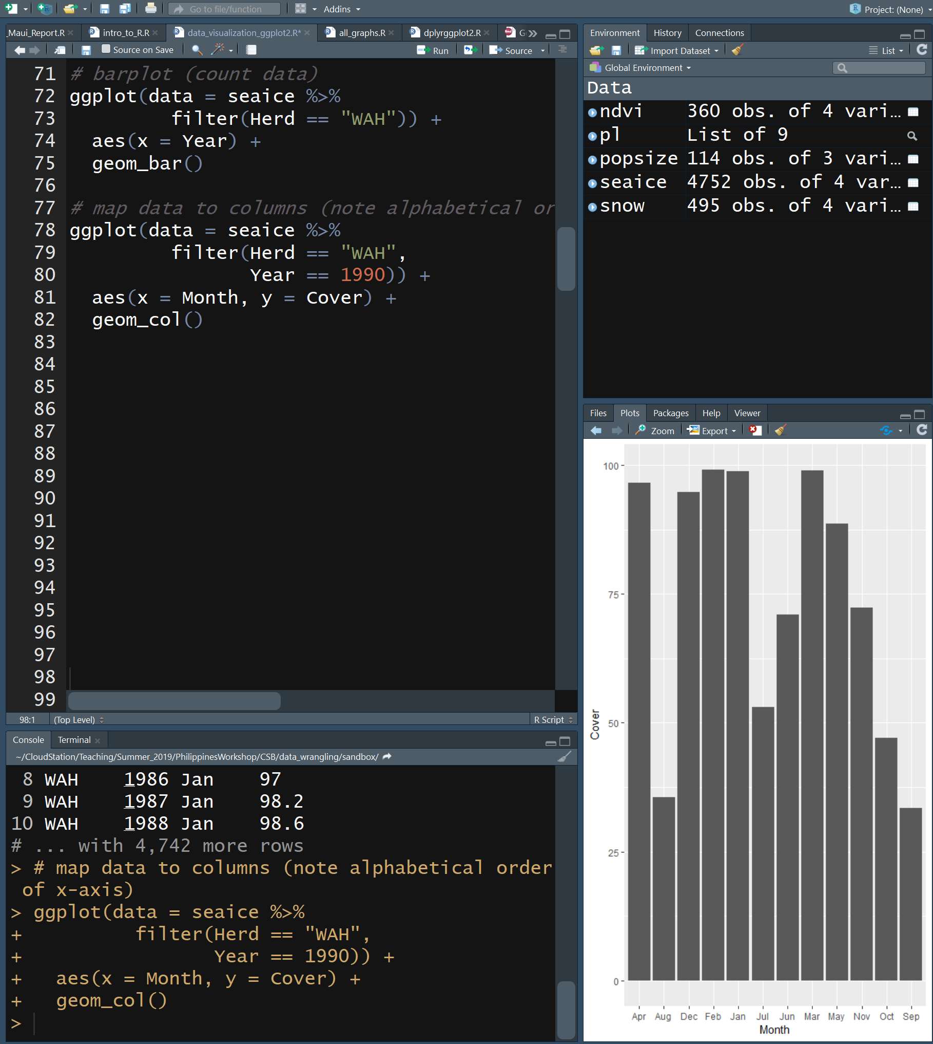
Bar Plots
Use bar plot to check if there’s 12 observations per year at site WAH
geom_bar()
counts up the number of times each year occurs
New Tidyverse command
filter(column == value)
Subset data by value, results in fewer rows
Plot cover of vegetation for each month in 1990
geom_col()
uses y to determine height of bar
Note the use of + to continue the “sentence”

Slide 13
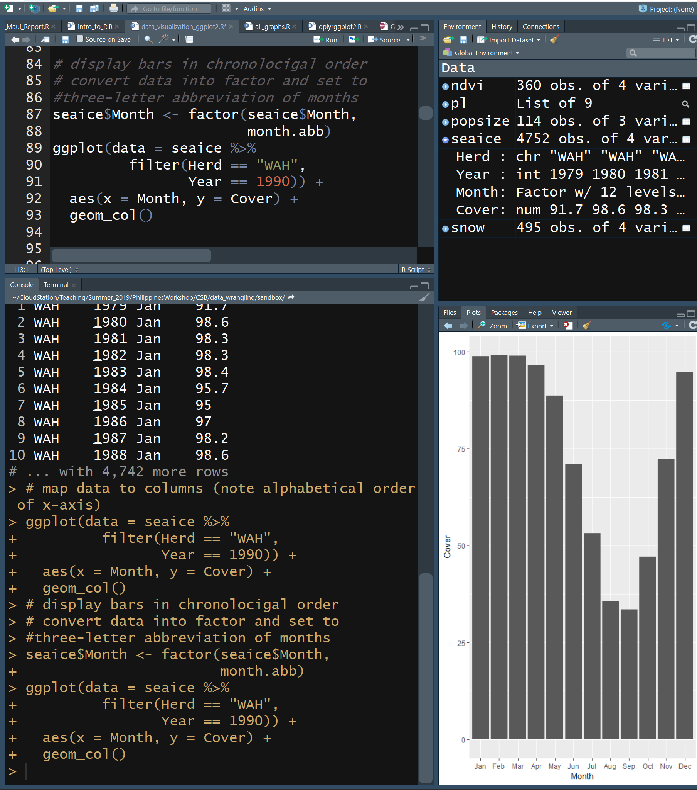
Bar Plots
Notice in the last plot that the months are out of order
New Tidyverse command
factor(column, format)
Changes data type to factor and has predefined formats
A factor is also an R data type
categorical variable
Note that barplots use a categorical variable on x axis
Note the use of + to continue the “sentence”

Slide 14
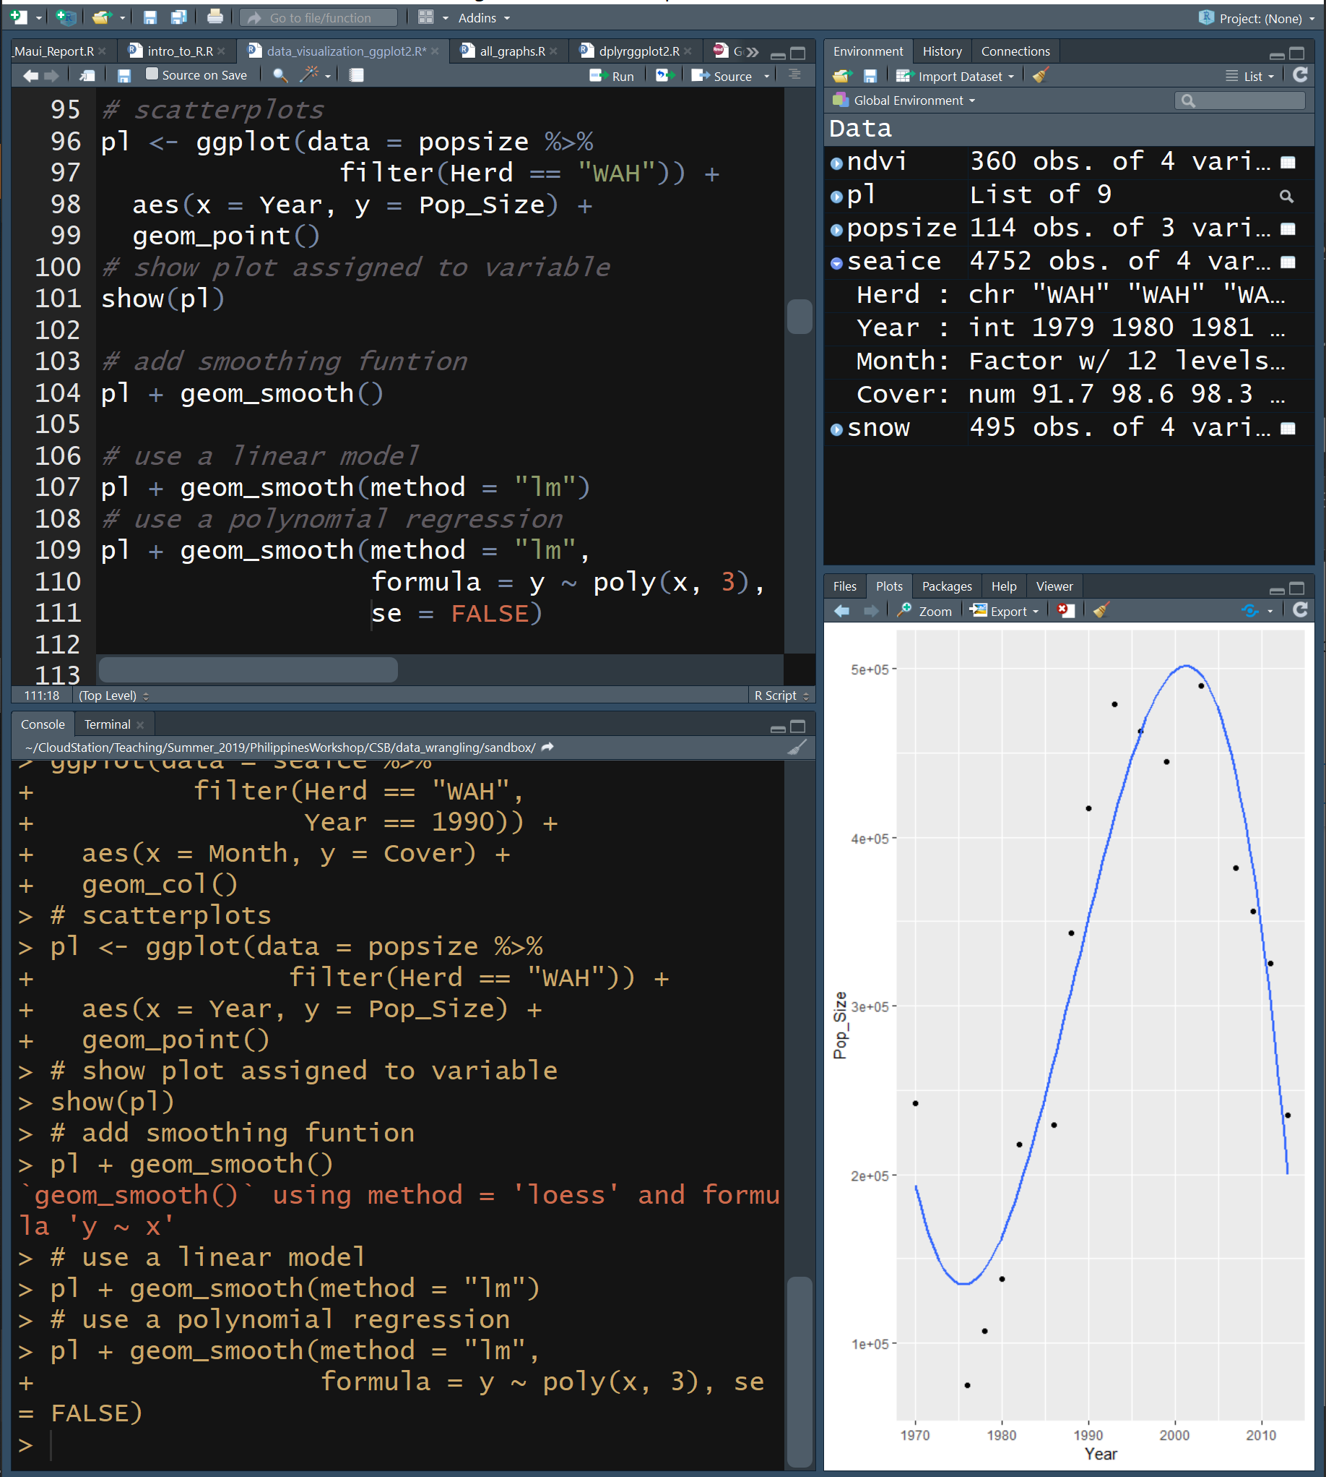
Scatter Plots
Visualize relationship between two continuous variables
We can show plot in variable
show(plotVarName)
Displays plot
Fit lines can be added
geom_smooth()
Uses loess smoother by default
geom_smooth(method=“lm”)
Linear model fit line
geom_smooth(method=“lm”, formula = y ~ poly(x,3))
3rd order polymonial model fit line
geom_smooth(se=FALSE)
Remove error “ribbon”
Note the use of + to continue the “sentence”

Slide 15
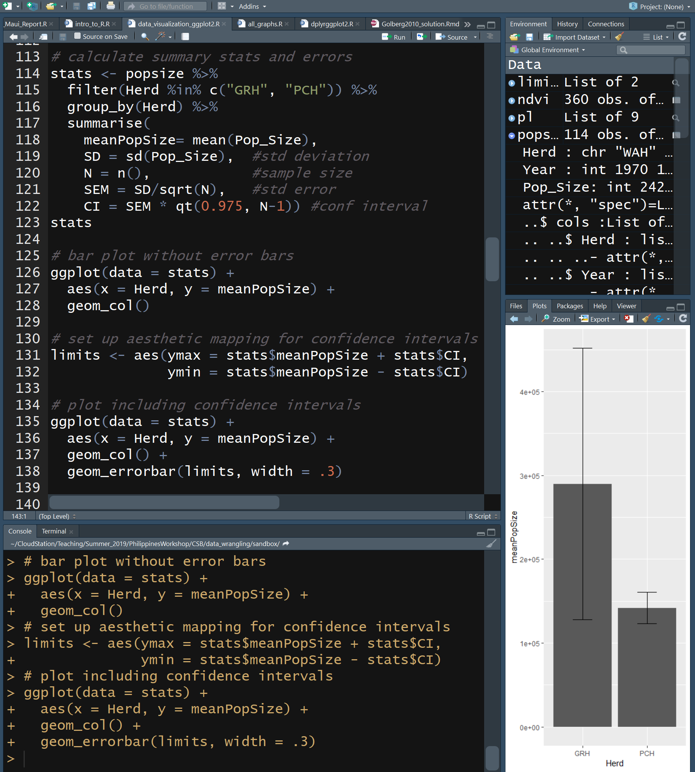
Plotting Experimental Errors
Error bars are typically plotted based upon values that you calculate
New Tidyverse commands
%in%
Equals
group_by(colName)
Converts tibble into a grouped tibble where operations are performed by group
See ungroup()
summarise()
Returns requested summary stats by group
Look at stats
Adding error bars
geom_errorbar(ymax,ymin)
Note the use of + to continue the “sentence”

Slide 16
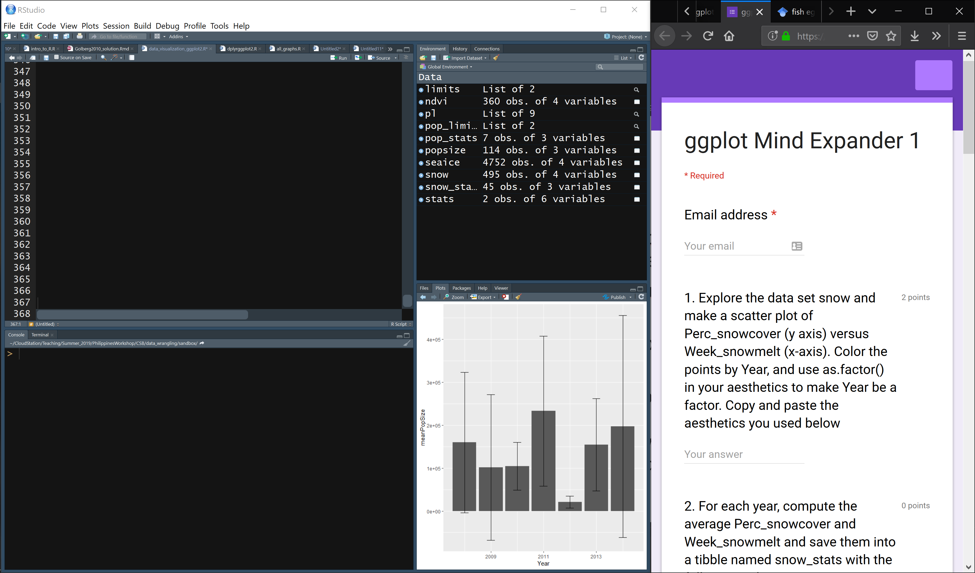

Slide 17
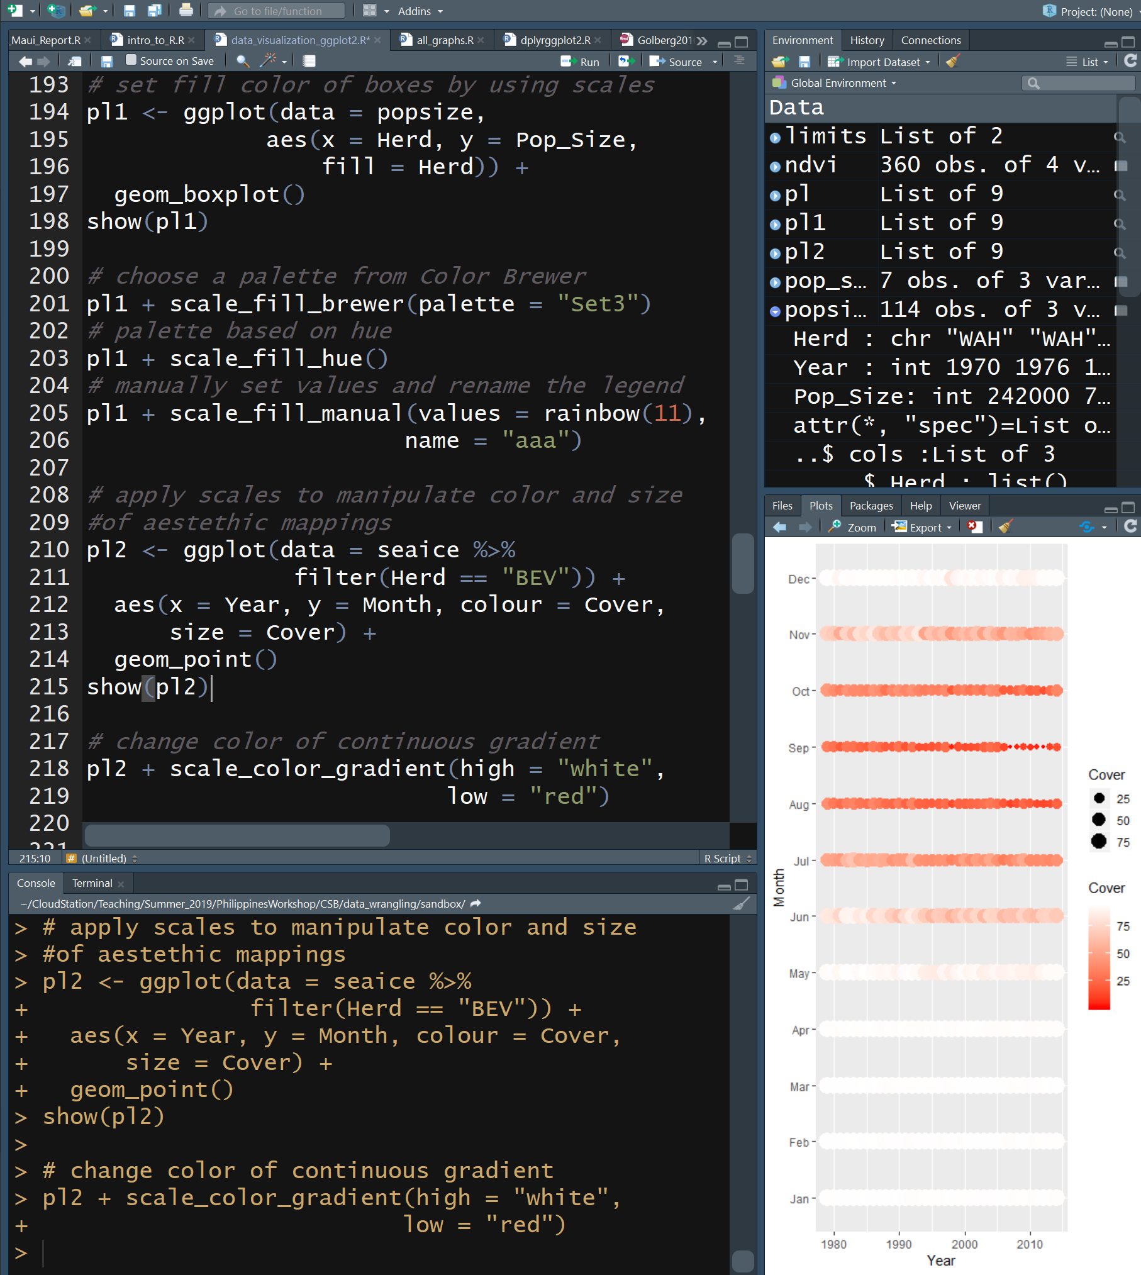
Scales
Modify the x and y axes, & determine how colors, sizes, shapes behave
fill
Color fill an object
colour
Color of border of object, point, line
I highly rec the RColorBrewer pkg
size
Size of point
shape
Shape of point
alpha
Level of transparency of point or bar
Discrete variables get discrete colors, continuous variables get continuous color
Compare pl1 to pl2
Note the use of + to continue the “sentence”

Slide 18
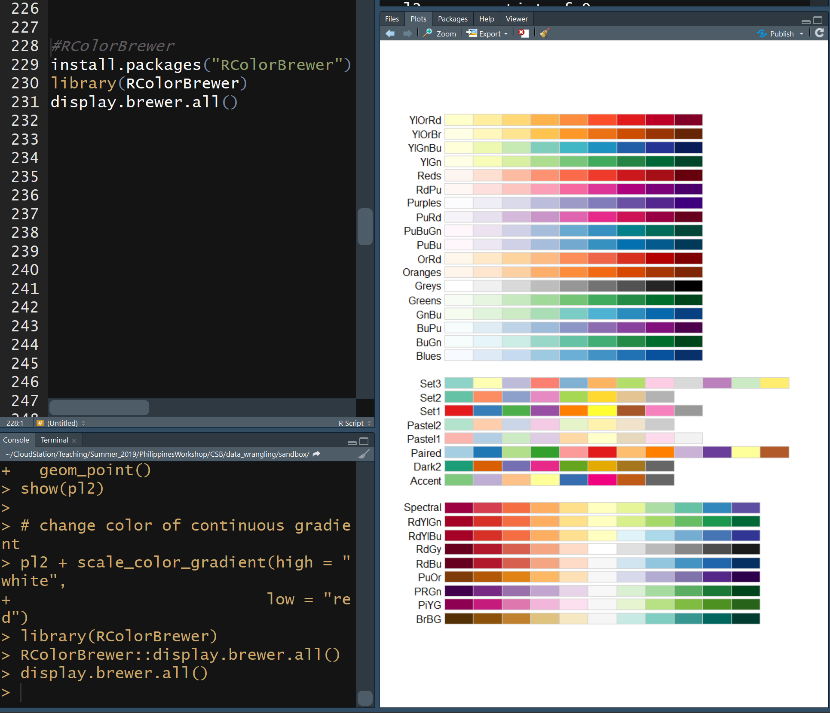
RColorBrewer
Package defining palettes of colors deemed to go together
Note the use of + to continue the “sentence”

Slide 19
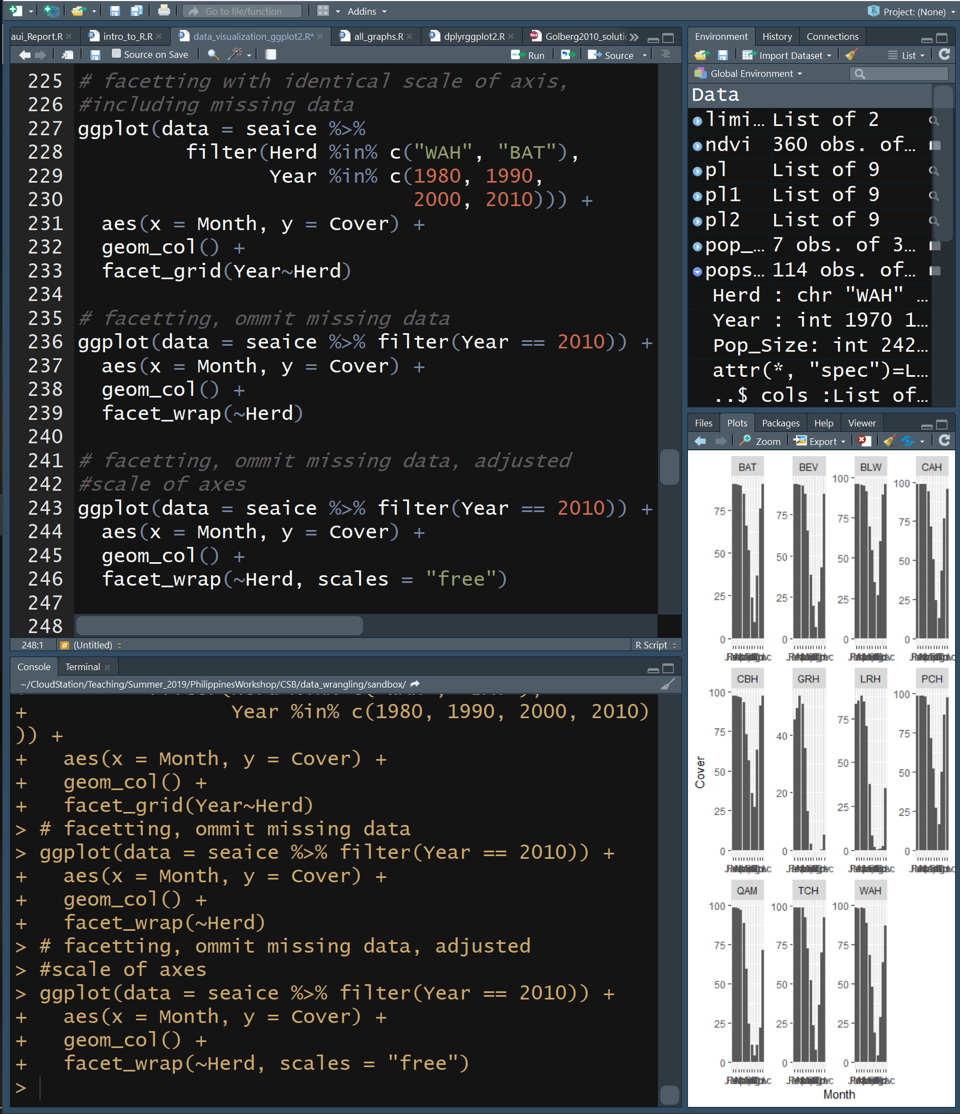
Faceting
Arrange like plots into panels by a categorical variable
facet_wrap(rowVar~colVar)
Skips empty panels
facet_grid(rowVar~colVar)
Does not skip empty panels
Make figures to see how ice dynamics have changed through the decades
Note the use of + to continue the “sentence”

Slide 20
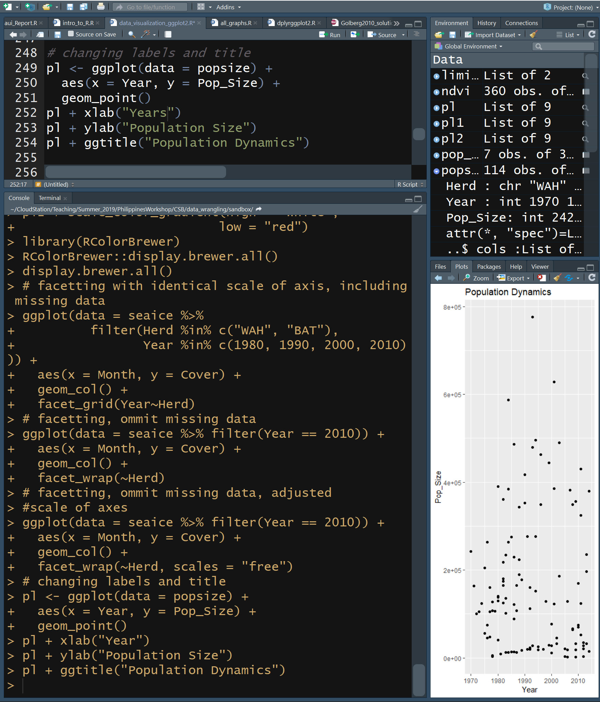
Labels
You can change axis and title labels
xlab(“Text”)
X axis label
ylab(“Text”)
Y axis label
ggtitle(“Text”)
title
Note the use of + to continue the “sentence”

Slide 21
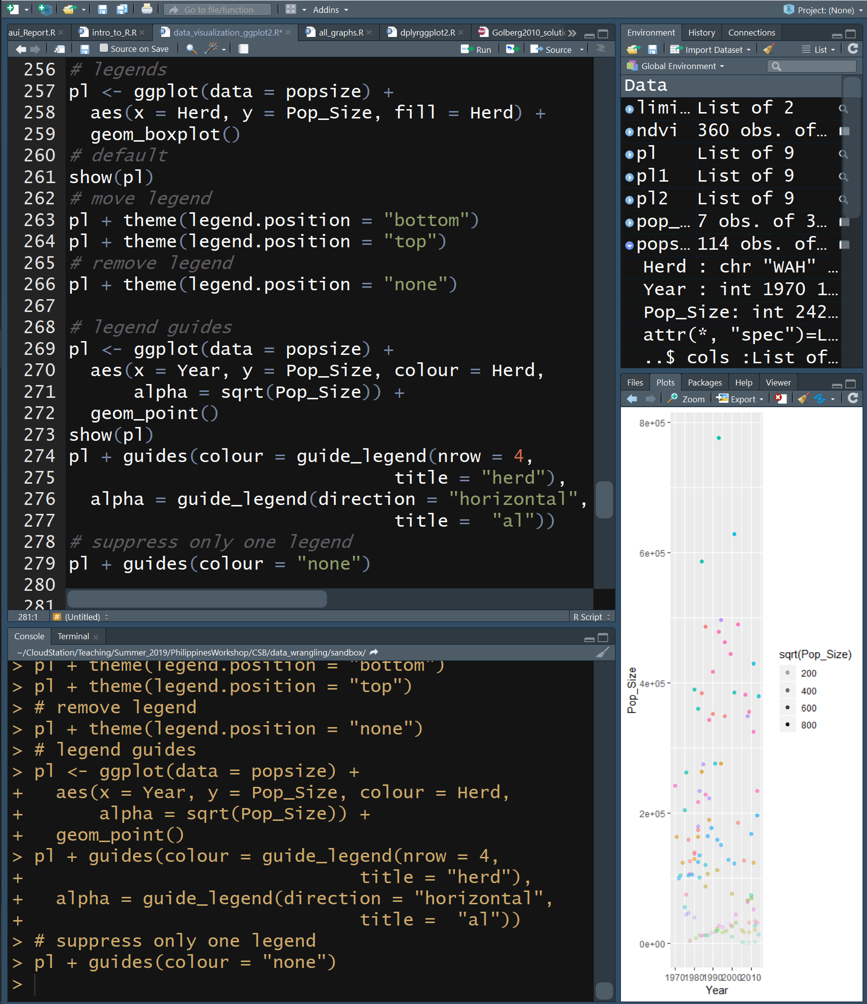
Legends
By default, legends are on the right, but you can control their position
theme(legend.position = “location”)
If the same column is mapped to both size and colour, one legend is made
If different features of the data are mapped into different aesthetics, legends are made for each feature
Each legend has guides() to change the legend title and features
For more info read documentation on guide_legend
Note the use of + to continue the “sentence”

Slide 22
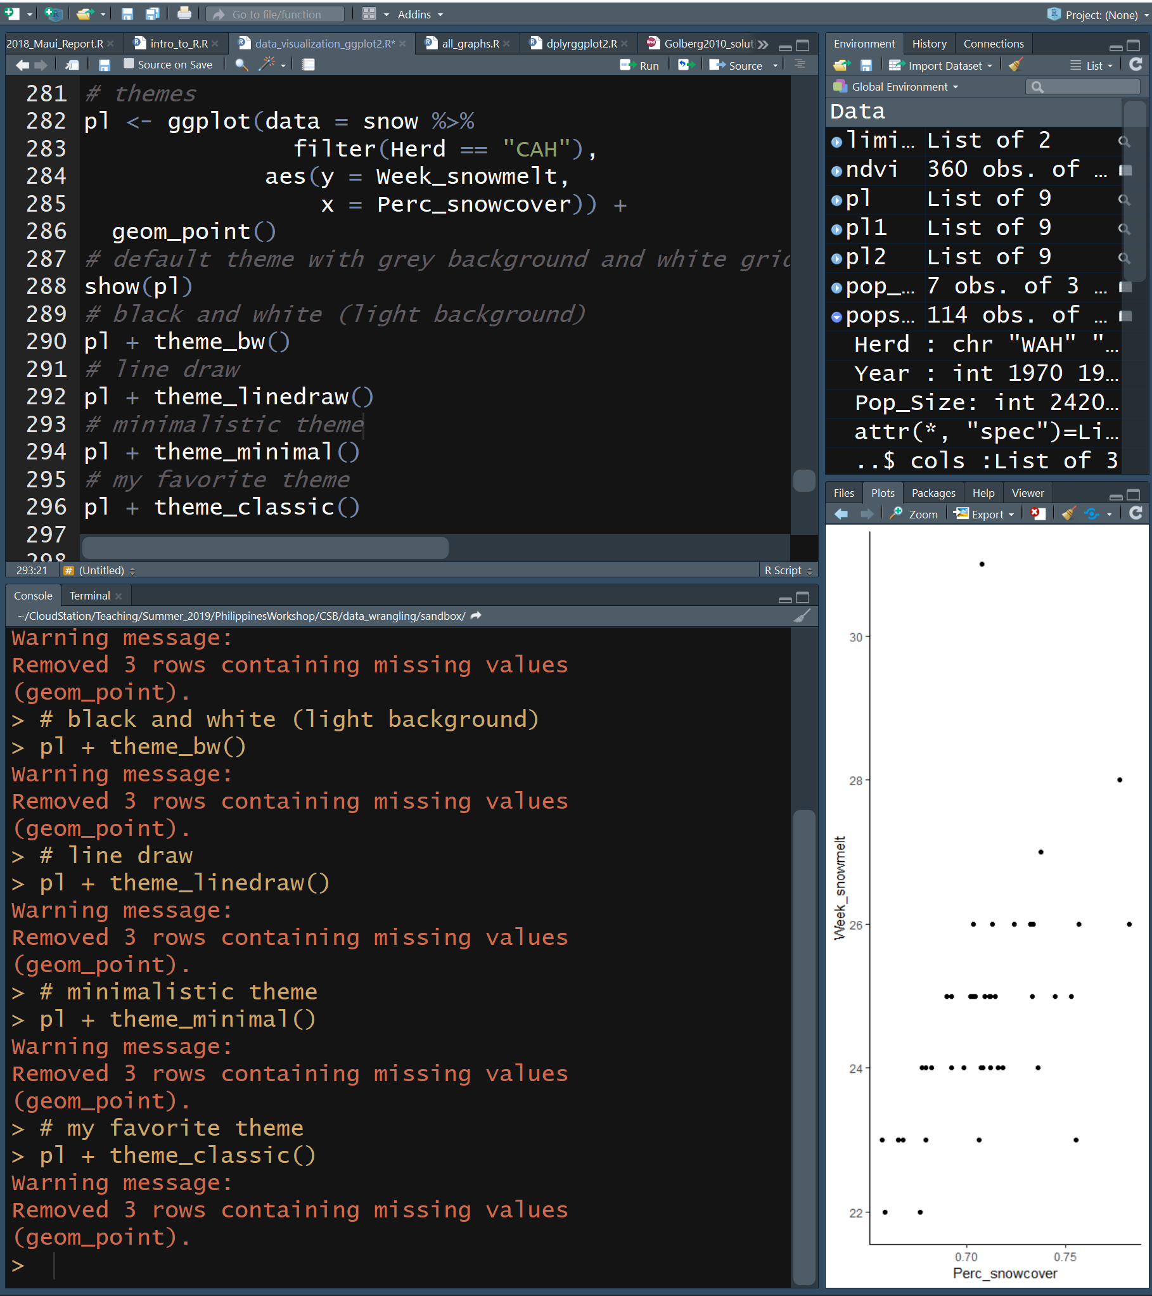
Themes
The general appearance of a plot can be controlled with themes
theme()
Control each element of theme independently
See documentation
There are several preset themes
theme_bw()
theme_minimal()
theme_classic()
It’s possible to create your own themes
See documentation
Note the use of + to continue the “sentence”

Slide 23
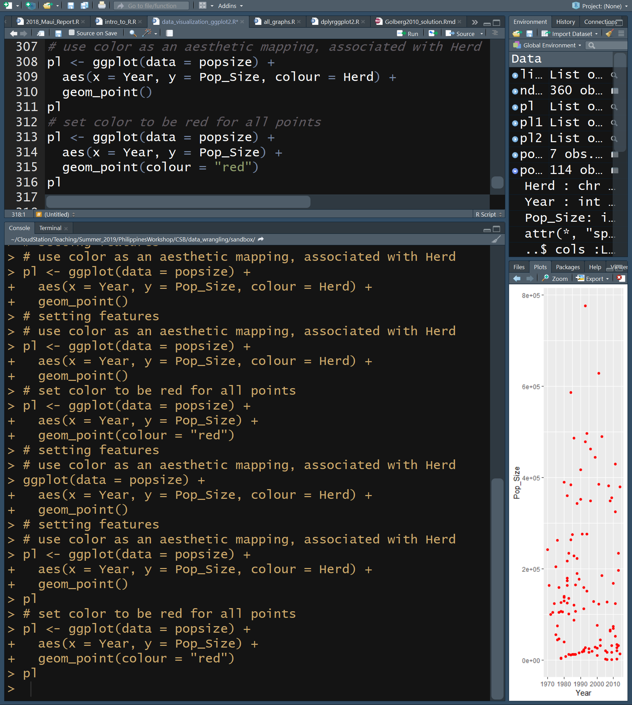
Setting a Feature
You can control the appearance of any and all features using ggplot
geom_point(colour = “color”)
Similarly, you can control size, shape, fill, alpha, and many other properties
Note the use of + to continue the “sentence”

Slide 24
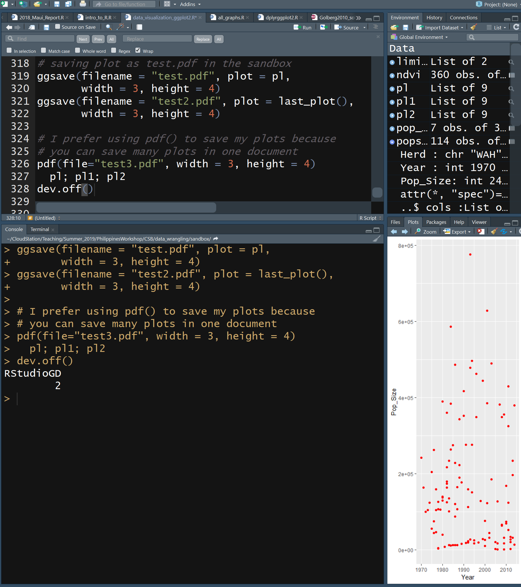
Saving a Figure
You can save your plots to a file with a certain size
ggsave(filename, plot, width, height)
Control each element of theme independently
See documentation
To save multiple plots to one file with each page being a different file, use:
pdf(filename, plot, width, height)
All plots between pdf() and dev.off() will be included. See documentation
dev.off()
If you don’t set the size of the figure, it will be scaled by the dimensions of the figure panel in R Studio
Note the use of + to continue the “sentence”

Slide 25
